Slide 1

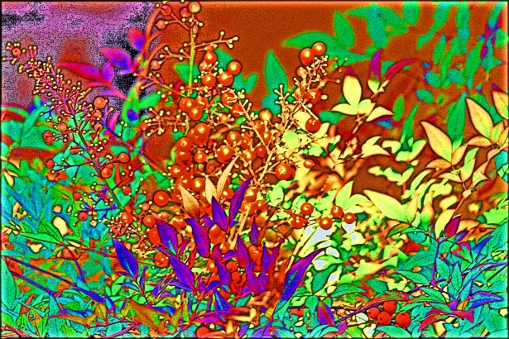
ColourSense
An AI model that can detect and classify colours
By- Arnav Singh

Slide 2
iNTRODUCTION
Colour recognition plays a crucial role in various industries and applications, including design, fashion, accessibility, and quality control. The ability to accurately detect and classify colours has numerous practical implications.
ColourSense is a Python-based AI model designed to identify and categorize colours accurately. By leveraging machine learning and computer vision techniques, it provides real-time colour recognition capabilities.

Slide 3
How does ColourSense work?
ColourSense is built using Python programming language: Python is a versatile and popular programming language known for its simplicity and extensive libraries, making it ideal for developing AI models.
It utilizes machine learning and computer vision techniques for colour recognition: The model is trained on a vast dataset of colour images, enabling it to learn patterns and characteristics associated with different colours.
The model processes the input image to extract colour information: It analyses the pixels in the image to identify colour values and their intensities.
Feature extraction is performed to identify key features and characteristics of different colours: The model looks for specific patterns, gradients, and colour combinations that distinguish one colour from another.
Classification is done using trained algorithms: Based on the extracted features, the model assigns a specific label to each colour detected.

Slide 4
Key Components of ColourSense
Image Processing: The model processes the input image using algorithms to extract colour information accurately.
Feature Extraction: It identifies key features and characteristics that distinguish different colours, enabling accurate classification.
Classification: Using trained algorithms, the model assigns a specific label to each colour detected, allowing for easy recognition and categorization.

Slide 5
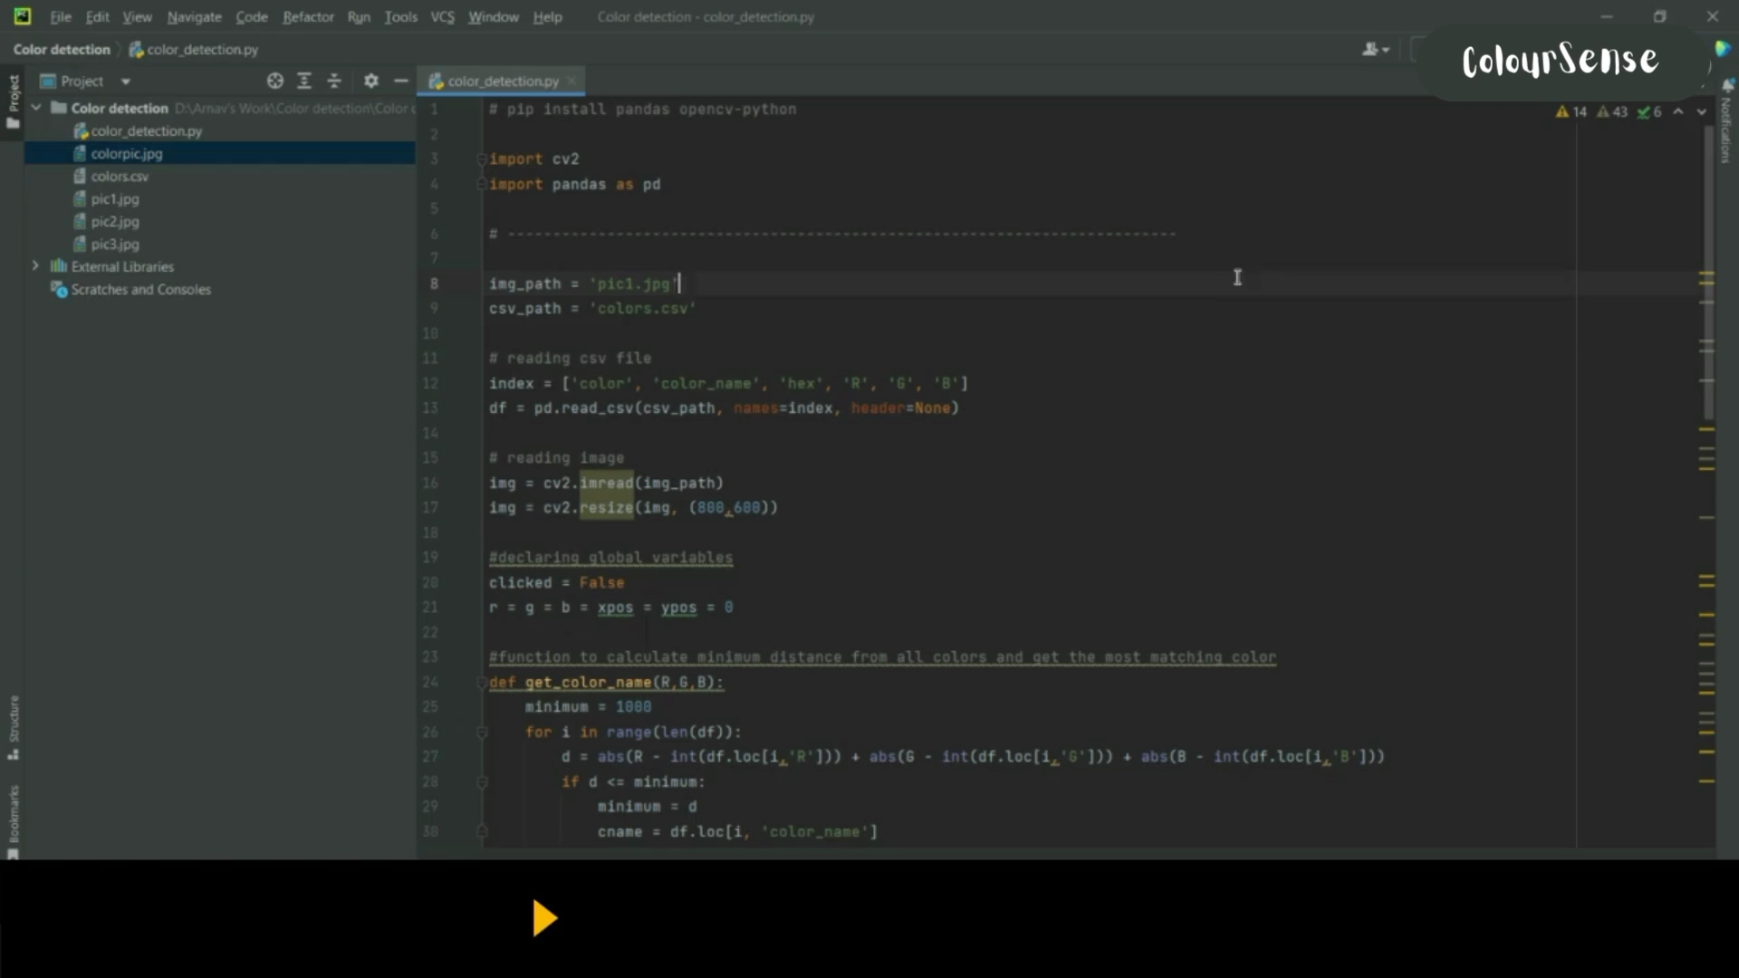
Demonstration of ColourSense

Slide 6
Applications of ColourSense
Design and Graphics: ColourSense assists designers in choosing harmonious colour schemes and palettes for their projects, enhancing visual appeal and aesthetics.
Fashion and Cosmetics: It helps in colour matching and coordination for clothing and makeup, allowing users to select colours that complement each other.
Accessibility: ColourSense aids visually impaired individuals in distinguishing and identifying colours in their surroundings, promoting independence and inclusivity.
Quality Control: The model ensures consistency and accuracy in manufacturing processes by verifying the correct colour usage and detecting any variations or deviations.

Slide 7
Benefits of ColourSense
Time-saving: ColourSense provides quick and automated colour detection without the need for manual effort, saving valuable time in various applications.
Precision: The model offers accurate classification of various colour shades and variations, enabling more precise colour analysis and decision-making.
Accessibility: By providing colour information to visually impaired individuals, ColourSense enhances their ability to navigate and interact with the world around them.
Efficiency: ColourSense streamlines colour-related processes in various industries, leading to improved productivity and optimized workflows.

Slide 8
Conclusion
Colour recognition is essential in various fields and the ColourSense AI model offers numerous advantages, including time-saving, precision, accessibility, and efficiency.
ColourSensehas the potential to revolutionize industries such as design, fashion, accessibility, and quality control, leading to improved outcomes and experiences.
Continued research and development in colour recognition can unlock even more possibilities and applications in the future.

Slide 9


